Slide 1

PSYLIQ INTERNSHIP
DATA ANALYST

Slide 2

DIABETES PREDICTION ANALYSIS

Slide 3
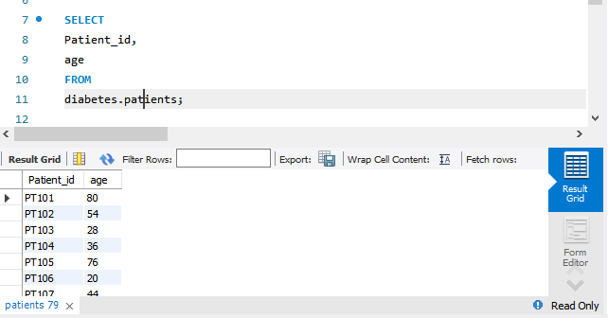
1. Retrieve the Patient_id and ages of all patients.

Slide 4
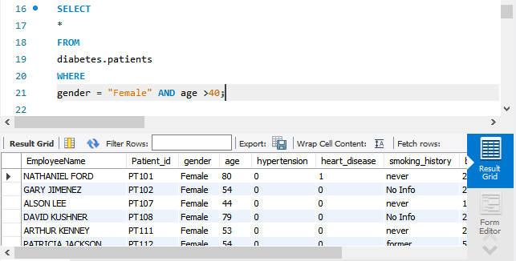
2. Select all female patients who are older than 40.

Slide 5
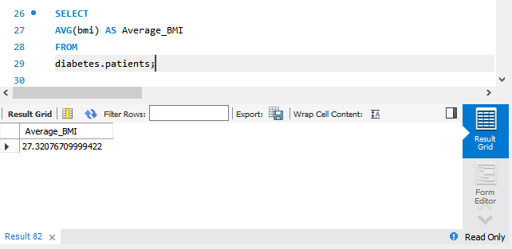
3. Calculate the average BMI of patients.

Slide 6
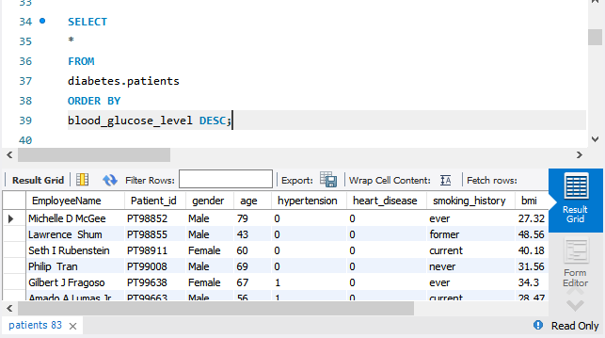
4. List patients in descending order of blood glucose levels.

Slide 7
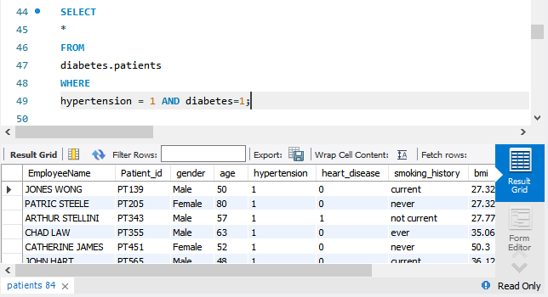
5. Find patients who have hypertension and diabetes.

Slide 8
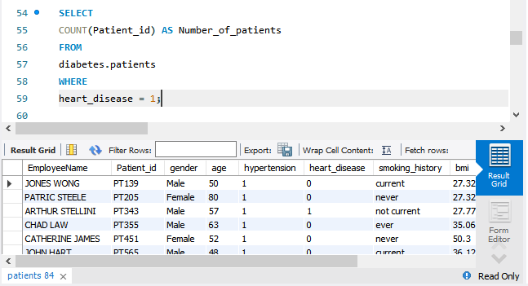
6. Determine the number of patients with heart disease.

Slide 9
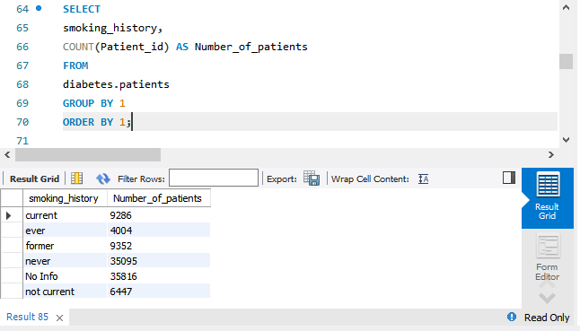
7. Group patients by smoking history and count how many smokers and nonsmokers there are.

Slide 10
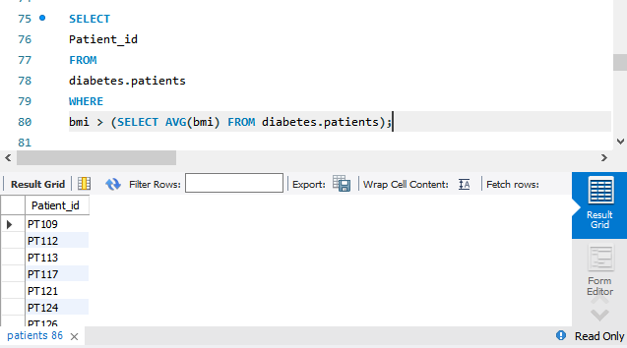
8. Retrieve the Patient_ids of patients who have a BMI greater than the average BMI.

Slide 11
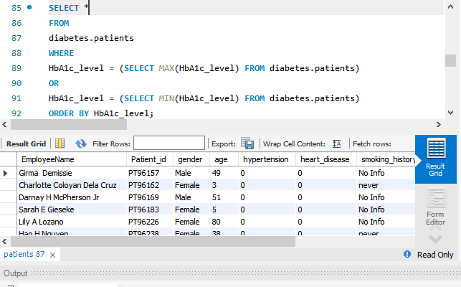
9. Find the patient with the highest HbA1c level and the patient with the lowest HbA1clevel.

Slide 12
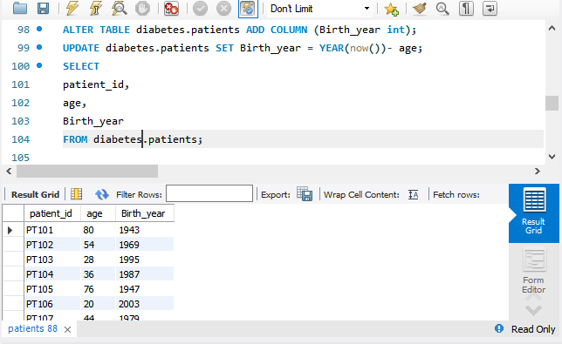
10. Calculate the age of patients in years (assuming the current date as of now).

Slide 13
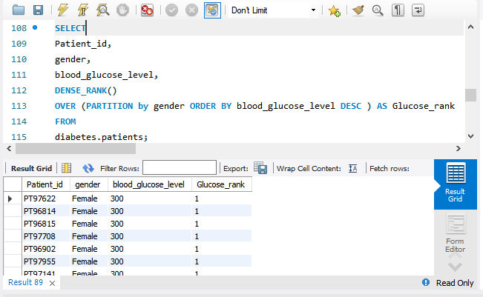
11. Rank patients by blood glucose level within each gender group.

Slide 14
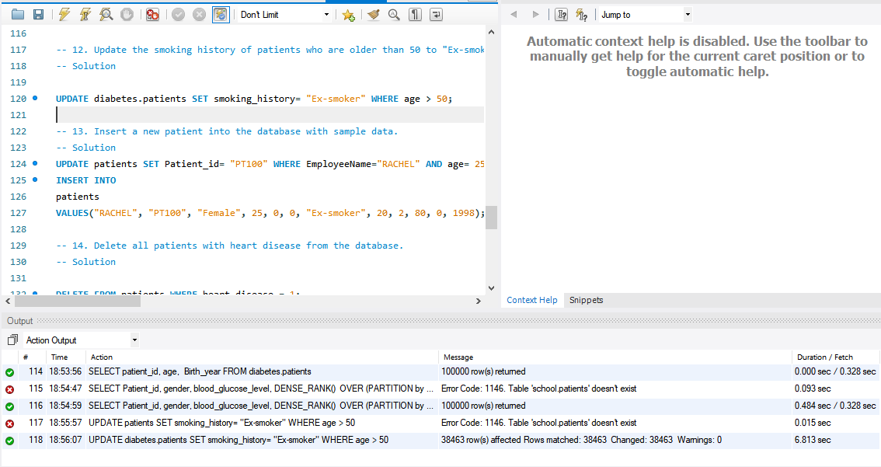
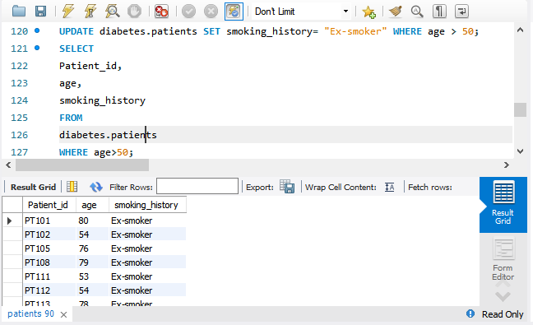
12. Update the smoking history of patients who are older than 50 to "Ex-smoker."

Slide 15
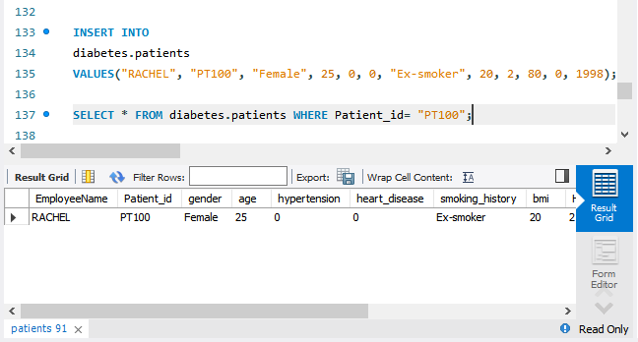
13. Insert a new patient into the database with sample data.

Slide 16
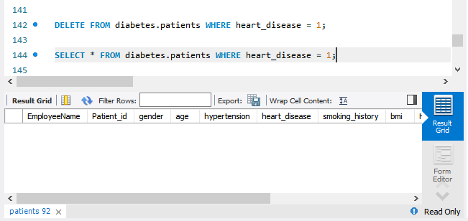
14. Delete all patients with heart disease from the database.

Slide 17
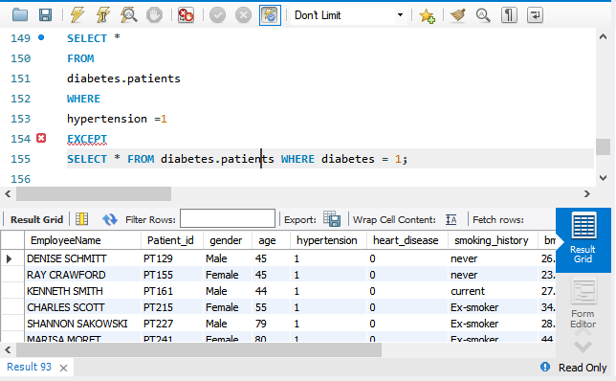
15. Find patients who have hypertension but not diabetes using the EXCEPT operator

Slide 18

16. Define a unique constraint on the "patient_id" column to ensure its values are unique.

Slide 19
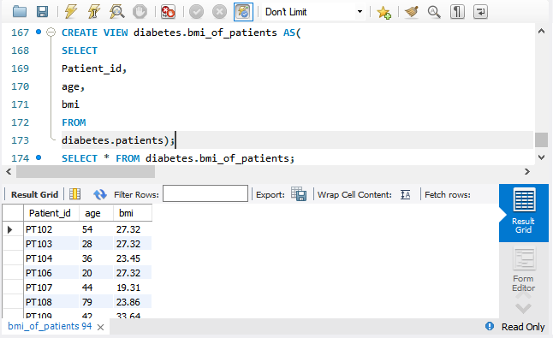
17. Create a view that displays the Patient_ids, ages, and BMI of patients.

Slide 20
18. Suggest improvements in the database schema to reduce data redundancy and improve data integrity.
Normalize Data: Break down data into smaller tables (1NF, 2NF, 3NF) to reduce redundancy.
Establish Relationships: Use foreign keys and constraints for data relationships.
Optimize Data Types: Choose efficient data types and sizes to save space.
Use Views and Indexes: Simplify queries with views; optimize performance with indexes.
Careful Denormalization: Consider denormalization selectively for performance.
Include Audit Trails: Implement logs for tracking changes and maintaining history.
Regular Maintenance: Schedule updates, backups, and consistency checks.
Enforce Validation Rules: Ensure strict validation during data entry.
Cleansing Procedures: Set up periodic data cleansing processes.
Stored Procedures: Utilize for complex data operations and code consistency.

Slide 21
19. Explain how you can optimize the performance of SQL queries on this dataset.
Indexing: Use appropriate indexes on frequently used columns.
Query Optimization: Select only needed columns, optimize WHERE clauses, and simplify joins.
Statistics Update: Regularly update statistics for efficient query plans.
Partitioning and Archiving: Partition large tables and archive older data.
Maintenance and Monitoring: Perform Regular maintenance and monitor performance.
Query Tuning: Identify and tune problematic queries using profiling tools.

Slide 22
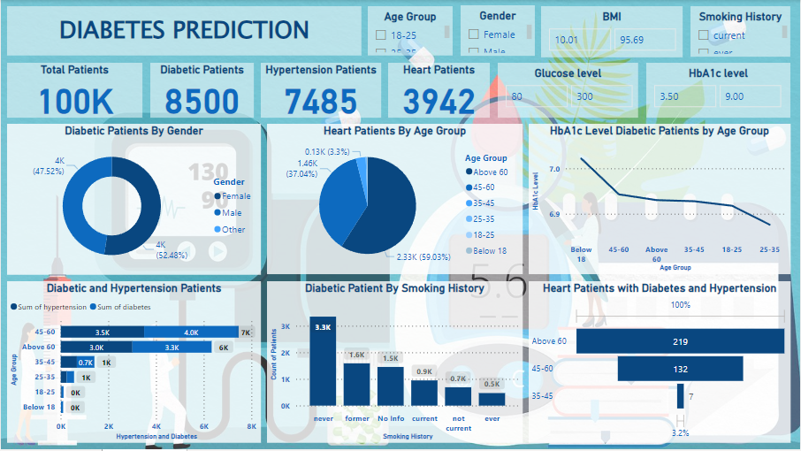

Slide 23

THANK YOU

